Slide 1
Feelings As Messengers
Feeling Families
Messages
  Sad
  Scared
  Mad
  Joyful
  Peaceful
  Powerful
  © VISIONS, Inc. 2015
  There is a loss
  I need comfort, space and / or support to grieve and let go
  There is danger
  I need protection, support and / or reassurance
  There is a violation
  I need to set limits and / or re-establish boundaries and expectations
  Keep on Keepin’ on!
© VISIONS, Inc. 2011

Slide 2
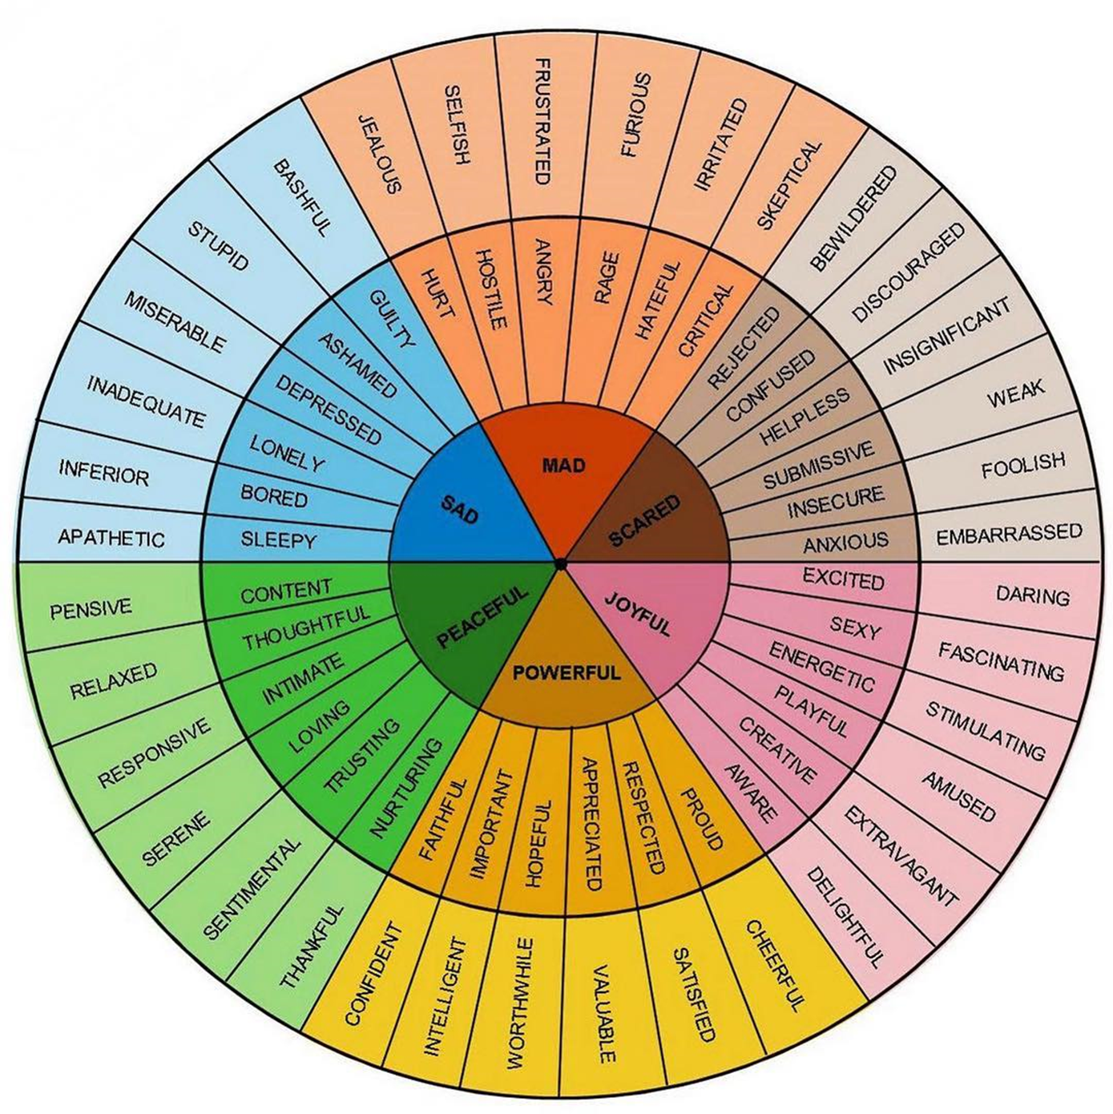
“The Feeling Wheel”
© Dr. Gloria Willcox – St. Lukes’
United Methodist Church

